Slide 1
Exploring venues categories in areas of high and low prevalence of obesity
Coursera Capstone by Corneliu Antonescu

Slide 2
Obesity
A complex disease involving an excessive amount of body fat.
Caused by a combination of inherited factors combined with environment factors, and personal choices in terms of diet and exercise
Best defined by Body Mass Index (BMI) :
BMI | Weight status
Below 18.5 | Underweight
18.5-24.9 | Normal
25.0-29.9 | Overweight
30.0 and higher | Obesity

Slide 3
Obesity across various regions
Obesity prevalence varies across regions
Are there variations in availability of places where people can engage in physical activity across regions, and if yes, how do these variations in availability correlate with obesity ?
How does the business venues mix vary in regions with high versus low obesity ?
We will be looking at states where low availability of places of physical activity correlates with high obesity. From these states we will be looking at the business venue mix (20 categories) in the counties with high versus low prevalence of obesity.
Our data providers are CDC surveys, county data aggregates provided by Robert Wood Johnson Foundation and FourSquare

Slide 4
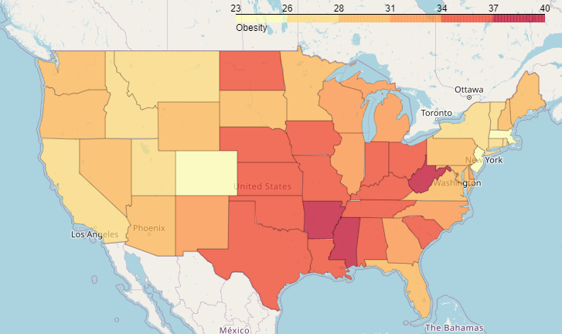
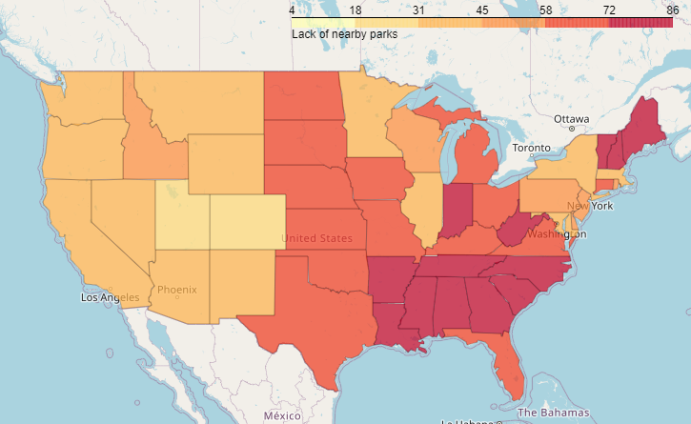
A look at the maps
Incidence of Obesity | States with higher number of people surveyed saying they don’t have a park within ½ mile
Not a match across the board, however the maps do bear some similarity

Slide 5
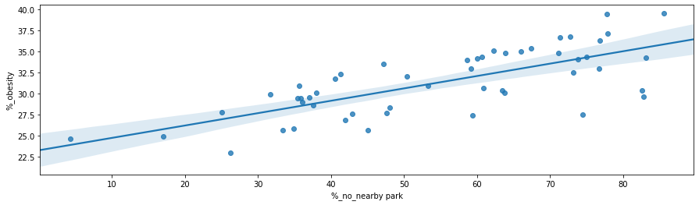
Lack of a nearby park vs Obesity
Linear regression confirms a higher incidence of obesity where more survey respondents indicate there is no nearby park

Slide 6
What are the states that rank highest and lowest for obesity and availability of parks ?
We found for some states on both lists that we will explore further. These are states where having a low or high rate of availability of physical activity correlates well with having a high or low obesity rate.
*The states on both tables were actually taken from states with populations in the interquartile range, to avoid comparing very large and very small states.

Slide 7
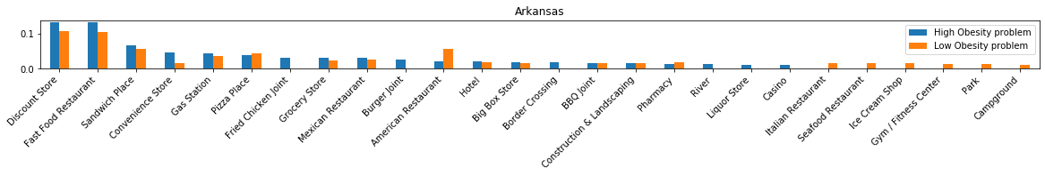
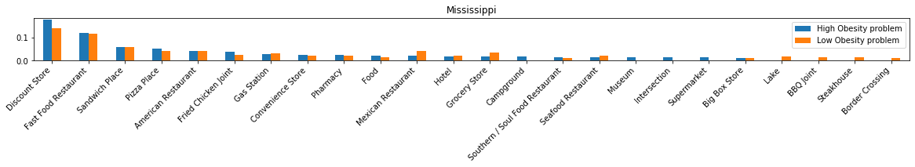
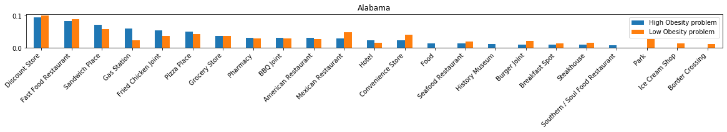
States with High Obesity Rates

Slide 8
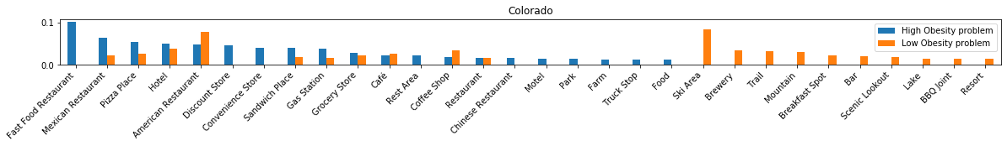
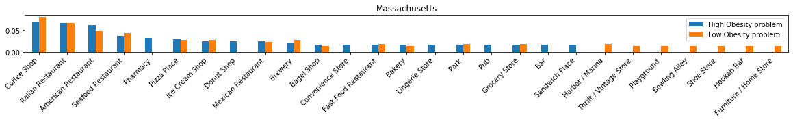
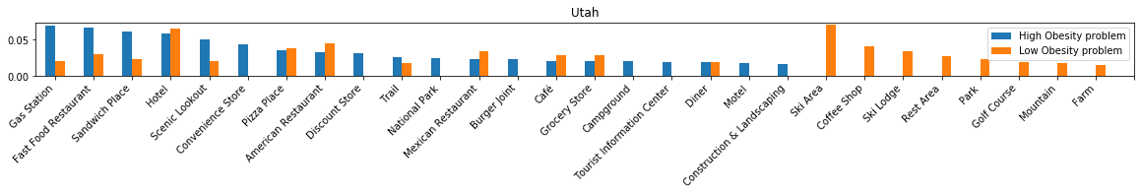
States with Low Obesity Rates

Slide 9
Results
States were prevalence of obesity is high, have a lot of discount stores, fast food restaurants, sandwich places, pizza places, and the counties with high prevalence of obesity vs low prevalence of obesity don’t have a much different ranking between ranking between these.
States of UT and CO are somewhat different because of the opportunities for outdoor activities provided by the mountain areas. In these states fast food restaurants, sandwich places, discount stores, pizza places are associated with high obesity.
In Massachusetts however the number of fast food restaurants, pizza places and discount stores is quite low in general (ranking in the second half as frequency both in the high and low obesity areas) .

Slide 10
Conclusion:
Analysis of the business categories in areas of hogh versus low incidence can provide interesting insights.

